Slide 1


Data Mining on
Home Forestation
Presented By
Presented To
Tanveer Hoque
ID: 153-15-6334
Ms. Zerin Nasrin Tumpa
Lecturer
Department of CSE
Daffodil International University.

Slide 3
Motivation

Slide 4
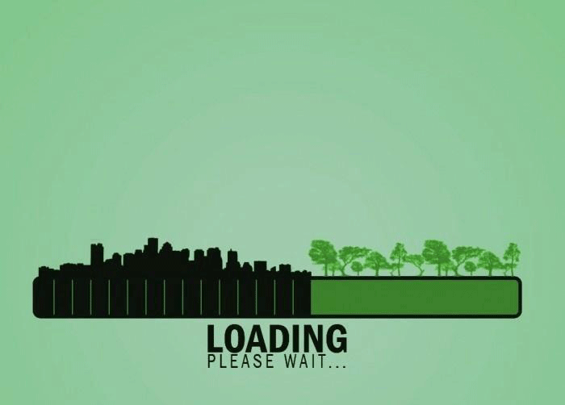
?

Slide 5

“ All Human Beings are in Danger
Because of Deforestation ”

Slide 6

“Death rate in Bangladesh is the highest of all around the world due to air pollution”

Slide 7

Problem

Slide 8




Recent Example

Slide 9
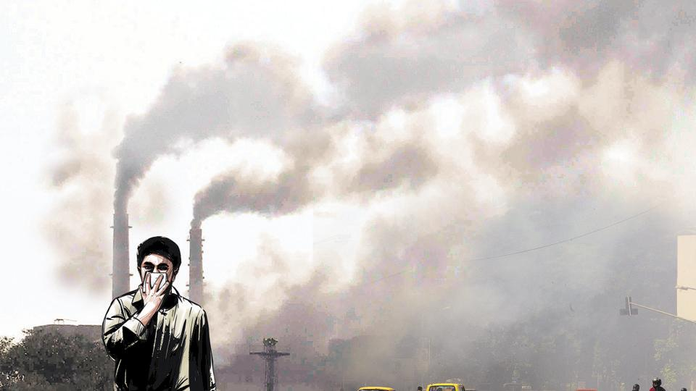

Every 1 out of 8 deaths
in the world is due to
air pollution
(WHO-2014)

Slide 10
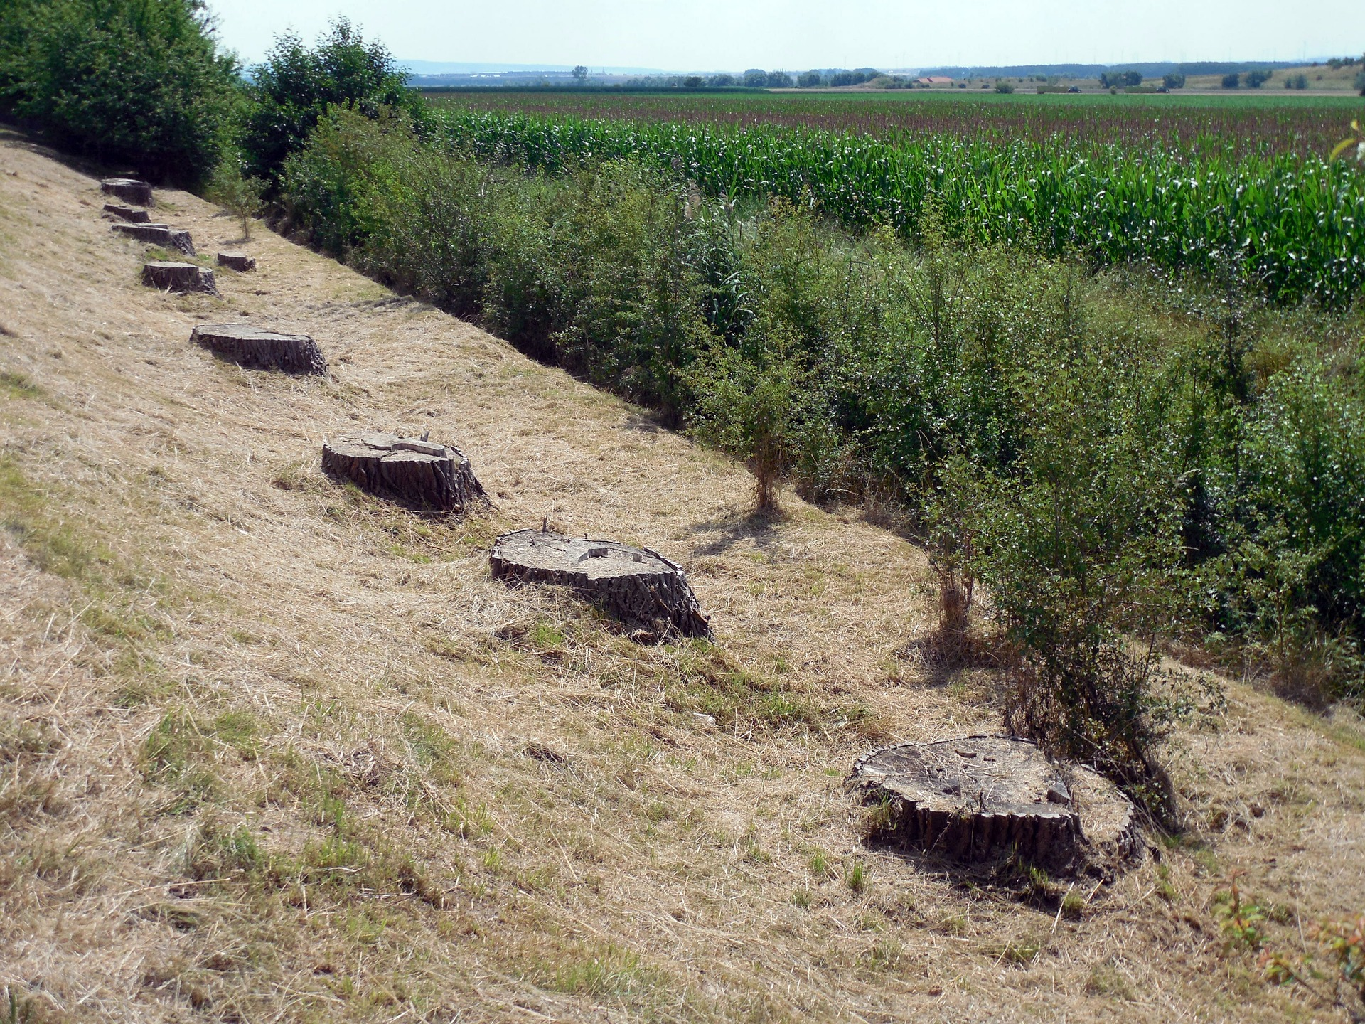
Global Statistics
Almost 50,000 sq. miles of forest lost/year
Amazon lost around 17% of the forest in the last 50 years
Rate of deforestation = 20 football fields/minute.
Estimated that there will be no rainforest within 100 years.

Slide 11
Statistics in Bangladesh
50% forests destroyed in last 20 years
Almost 1.2 lakhs people die per year due to air pollution
8.5 million peoples are attacked by asthma and 7.5 by bronchitis
24% students are facing lungs problem

Slide 12
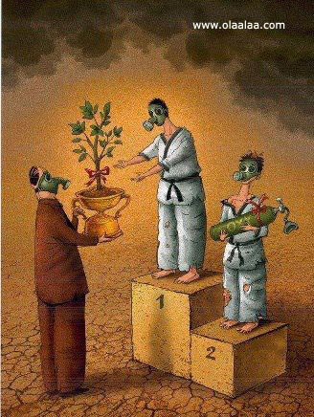

Slide 13

Where will you plant tree
???

Slide 14


Slide 15
Objective

Slide 16
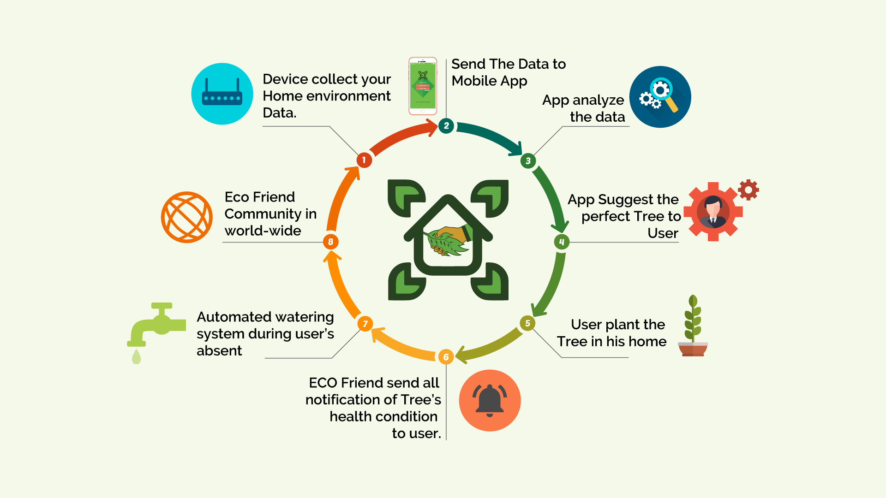
How Eco friend Works

Slide 17
Architecture

Slide 18
Expected outcome

Slide 19
Expected outcome
Data mining tool
Collect Information
Send data to Central Server
Server matches mined database
Returns detailed info of trees suitable for the environment

Slide 20


Other Similar Devices
Growtronix
Niwa

Slide 21


Slide 22


